Slide 1
Syntactic and Statistical parsing

Slide 2
Syntactic & statistical Parsing
What is Syntactic parsing,
Ambiguity,
Attachment Ambiguity,
Coordination Ambiguity.
CKY Parsing
Conversion to Chomsky Normal Form,
Probabilistic Context-Free Grammars,
Probabilistic CFG Parsing
Ambiguity in CFG
Managing ambiguity in CFG

Slide 3
Syntactic Parsing (Constituency)
It refers to the breaking down of a text or sentences into its constituents.
Composed of:
Terminals(words)
Non-terminals(phrases/sentences)
Parse trees are used in grammar checking while word processing.

Slide 4
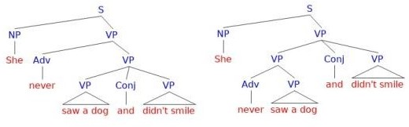
Ambiguity
Structural ambiguity : It is similar to the grammatical phrase structuring.
It occurs when a sentence has a grammar that can be parsed more than once for e.g.

Slide 5
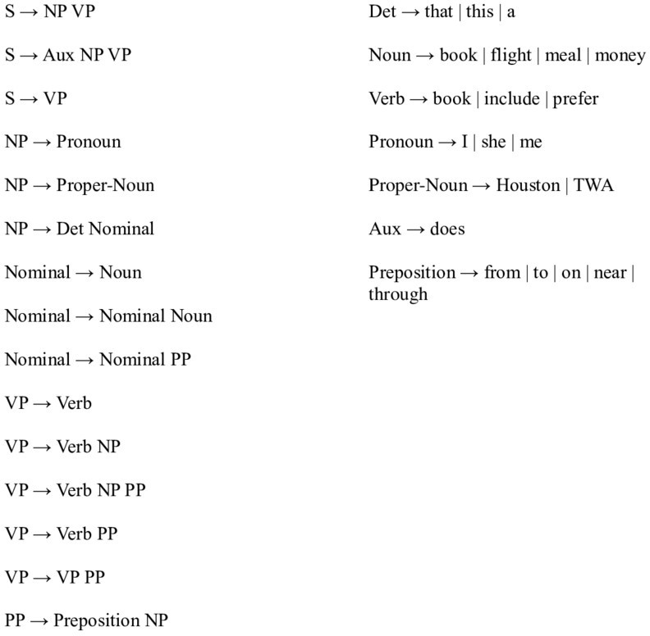
The two types of ambiguity are:
Attachment ambiguity: Constituent or a part of a sentence that can be
attached to a parse tree multiple times.
Coordination ambiguity: Conjunctions are used to join two different
phrases. e.g. the thief shot the jeweler and the cop panicked.

Slide 6
CKY Parsing or Cocke-Kasami-Younger algorithm
Handles syntactic disambiguation with the help of dynamic programming.
Chomsky normal form
At the beginning of the CKY algorithm we need to convert the CFGs to CNF.
Unit productions are formed when there is a single non terminal towards the right.
S → Aux NP VP S → XI VP
XI → Aux NP

Slide 7
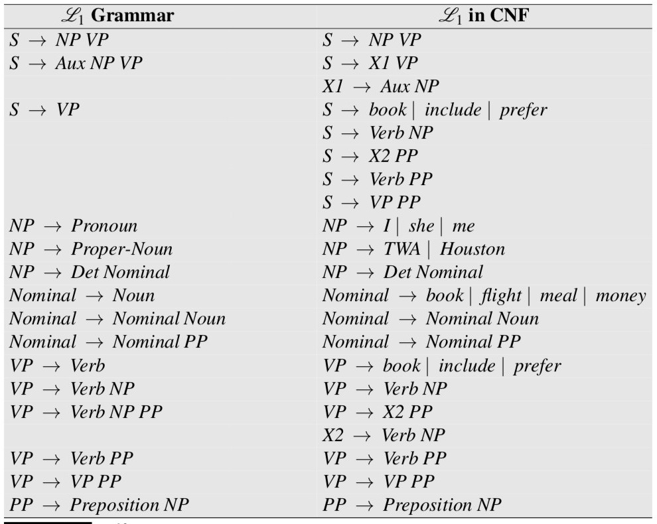
Copying all the conforming rules to a new grammar.
Conversion of terminals to non-terminals.
Conversion of unit products.
All the new rules are made binary and added to new grammar.

Slide 8
Statistical Constituency Parsing
It is possible to build probabilistic parsers consisting of syntatic knowledge.
PFGCs or probabilistic context-free grammar which is an enhancement of CFG.
A probability is assigned to each rule.
These are trained on treebank grammars.
Non-terminals are made more specific or more general.
Also known as Stochastic context-free grammar SCFG.
Consists of N= non-terminal symbols, Σ=terminal symbols, R=rules or productions A→....β[p], β=string of symbols (ΣUN)*, and p is a number between 0 and 1 P(β|A) and S= start symbol.
R is augmented with a conditional probability:
A→β[p]
P→(A→β) P→(A→β|A) P(RHS|LHS)
ΣP(A ->β)

Slide 9
Probabilistic CKY Parsing PCFGs
The probabilistic CKY concludes that the PCFG is in the Chomsky normal form.
Indices are assumed between each word.
These are considered and each constituent in the CKY parse tree is encoded
in a two dimensional matrix.
The upper triangular portion of the matrix is used (n+1)x(n+1) matrix.
Each cell table [i,j] contains a list of constituents that spans a sequence of words from i to j.
The sentence “ the flight includes a meal” is connected to chomsky normal form in order for the CKY algorithm to work on it and to handle the rule properties.
Separate counts are needed for each constituents in the PCGs using the
Inside-out algorithm.

Slide 10
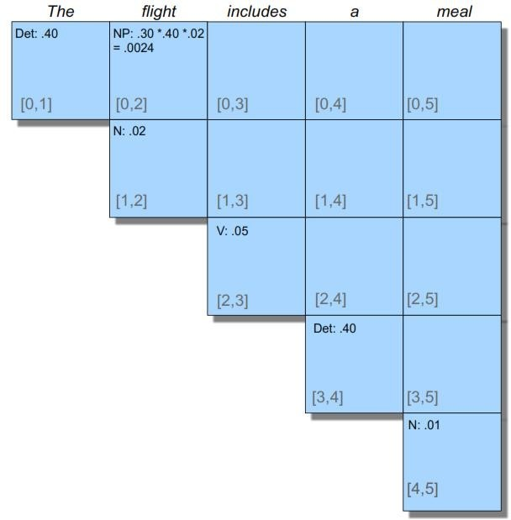
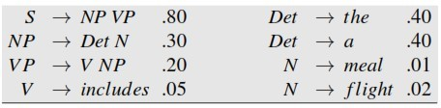
Probabilistic CKY Parsing PCFGs

Slide 11
Problems with PCFGs
Poor independence assumptions: CFG rules impose an independence assumption on probabilities that leads to poor modeling of structural dependencies across the parse tree.
Lack of lexical conditioning: CFG rules don't model syntactic facts about specific words, leading to problems with sub categorization ambiguities, preposition attachment, and coordinate structure ambiguities.

Slide 12

Probabilistic CFG Parsing
Lexicalized grammar frameworks such as CFG pose problems for which the phrase based methods we've been discussing are not particularly well-suited.

Slide 13
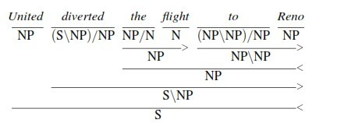
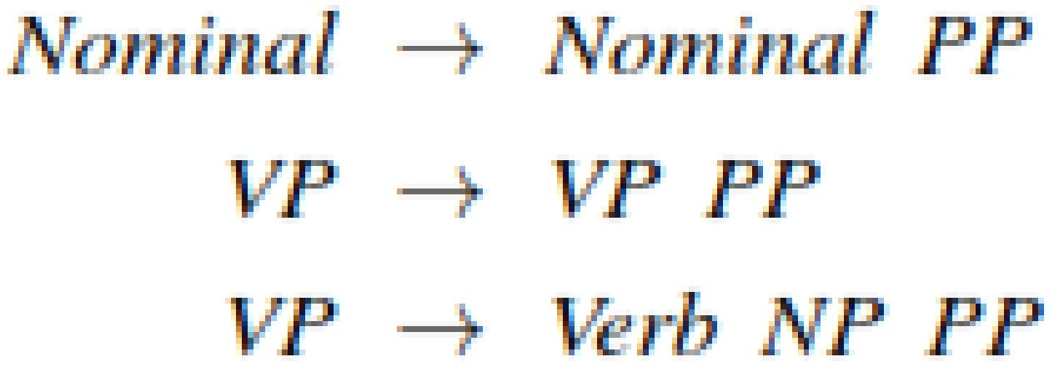
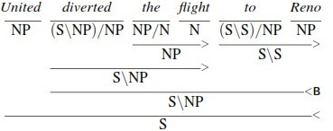
Ambiguity in CFG

